Slide 1
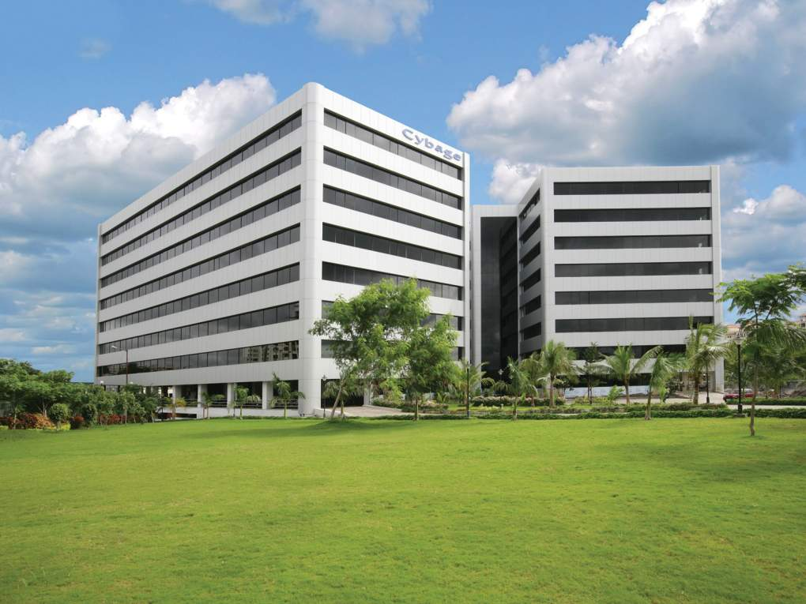

Welcome to Cybage
This document and all its contents contain information from Cybage Software Private Limited which may be privileged, confidential, or otherwise protected from disclosure. The information is intended to be for the addressee(s) only. Any unauthorized disclosure, copy, distribution, or use of the contents of this message is strictly prohibited.

Slide 2
Agenda
Infra team – Pain areas
DevOps
Docker vs KVM
Evolution in Virtualization History
Docker
Containers
Docker Workflow
Dockerfile
Docker Commands
Use cases for Docker
Application Deployment using Docker containers

Slide 3
Infra team – Pain areas
Dev, Test, Prod environments are different
Prod Env –
Downtime issues
Fire fighting issues
Golden Images
Higher Cost – at machine/VM level
Higher storage requirements for Golden Images
Manual process of creating Environments - for Dev, Test teams
How to Snapshot the Environments
Manual release process

Slide 4
DevOps value addition to Infra team
Same environments for Dev, Test and Prod
Faster to create/manage Environments
Easy to take Snapshot of Environments
Portability of Apps
Easy to build, test and deploy Apps
Deployment automation
Faster and more releases
Lower cost on storage & CPU
Zero downtime
Green/Blue deployment

Slide 5
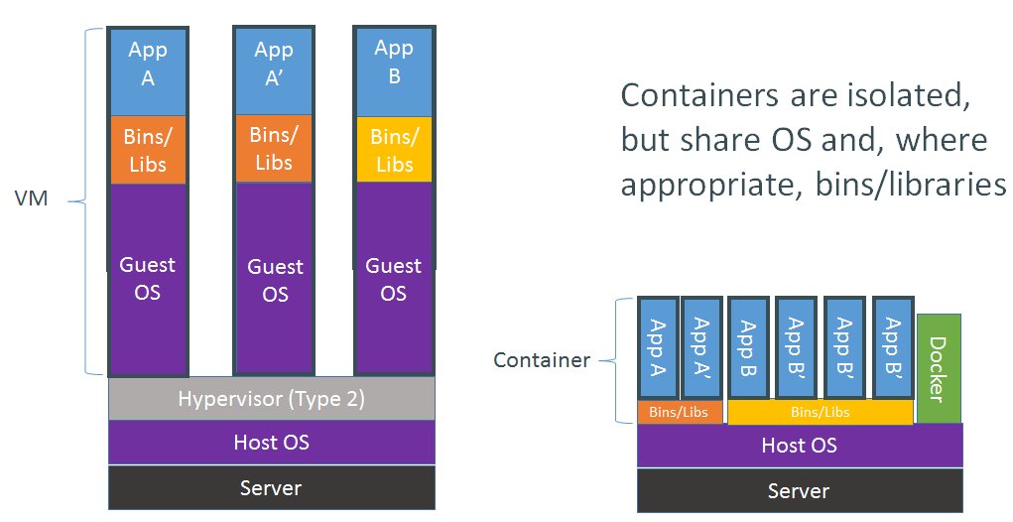
Docker Container vs VM

Slide 6
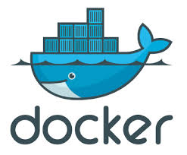
Docker
What is Docker ?
Docker automates creation of lightweight - Application container
Container will virtually run anywhere
Same container can run on any laptop, desktop, VM, Cloud & more
Deployment of Applications inside an Container
Unlike VM, it does not include a separate Operating system.
Why Docker ?
Speed: Boots in seconds
Footprint: 100-1000 containers on one machine
Small Disk/CPU requirements as compared to VM's
Portability
Supported by all Cloud providers

Slide 7
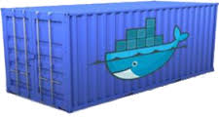
Containers
What is Container ?
“Unit of deployment”
LXC - OS virtualization
Lighter than VM/Golden Images
Why Containers ?
Boots in seconds
100-1000 containers on one Machine/VM
Same Container can be deployed to any Dev, Test & Prod servers

Slide 8
Dockerfile, Image, Container
Dockerfile
Image
Container
Build
Run

Slide 9
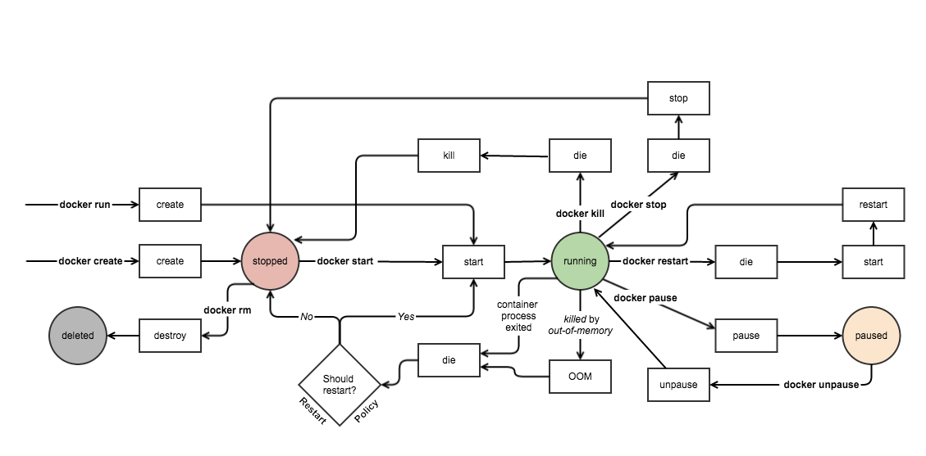
Docker Workflow

Slide 10
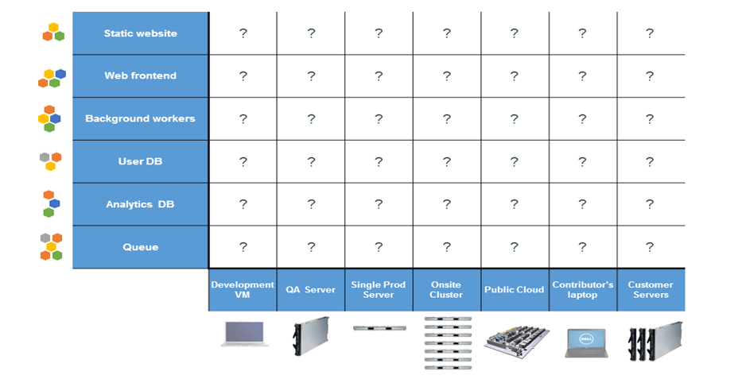
The Matrix From Hell

Slide 11
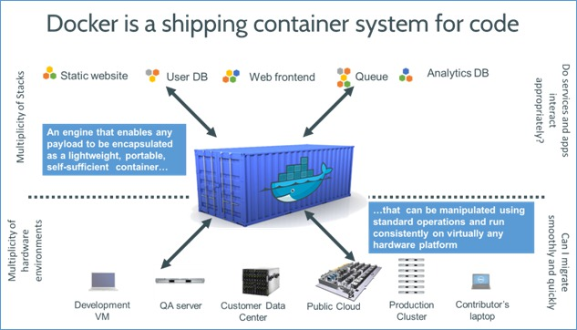
Ship an Application Container

Slide 12
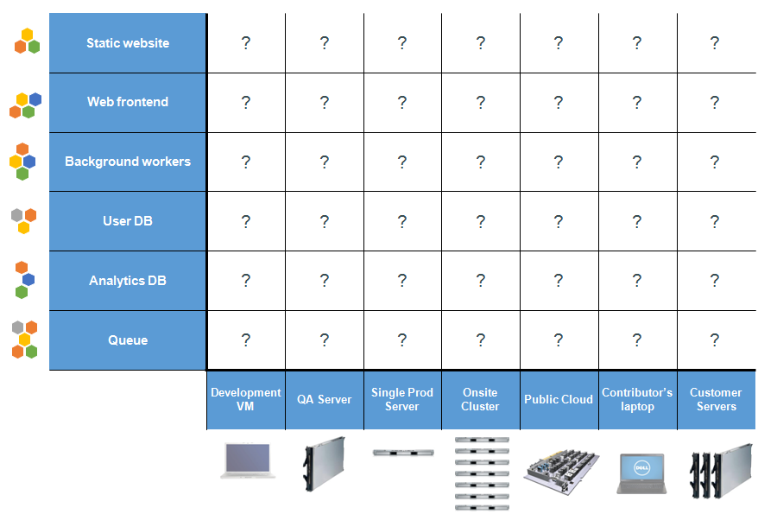
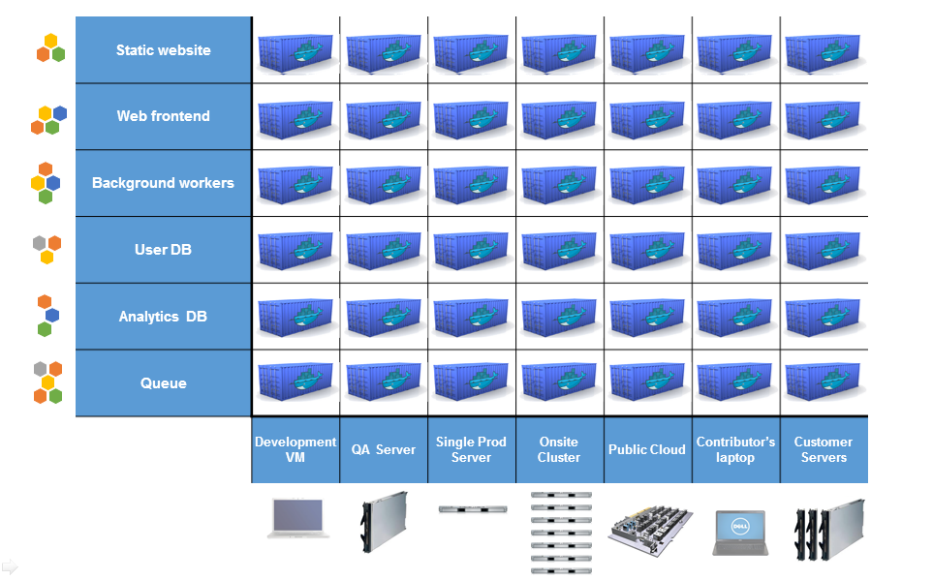
Docker eliminates the matrix from Hell

Slide 13
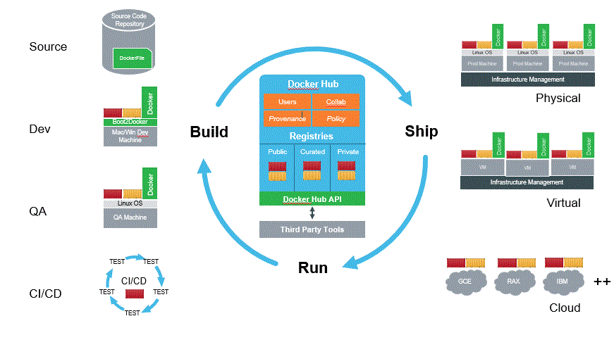
Docker – Build , Ship And Run Apps

Slide 14
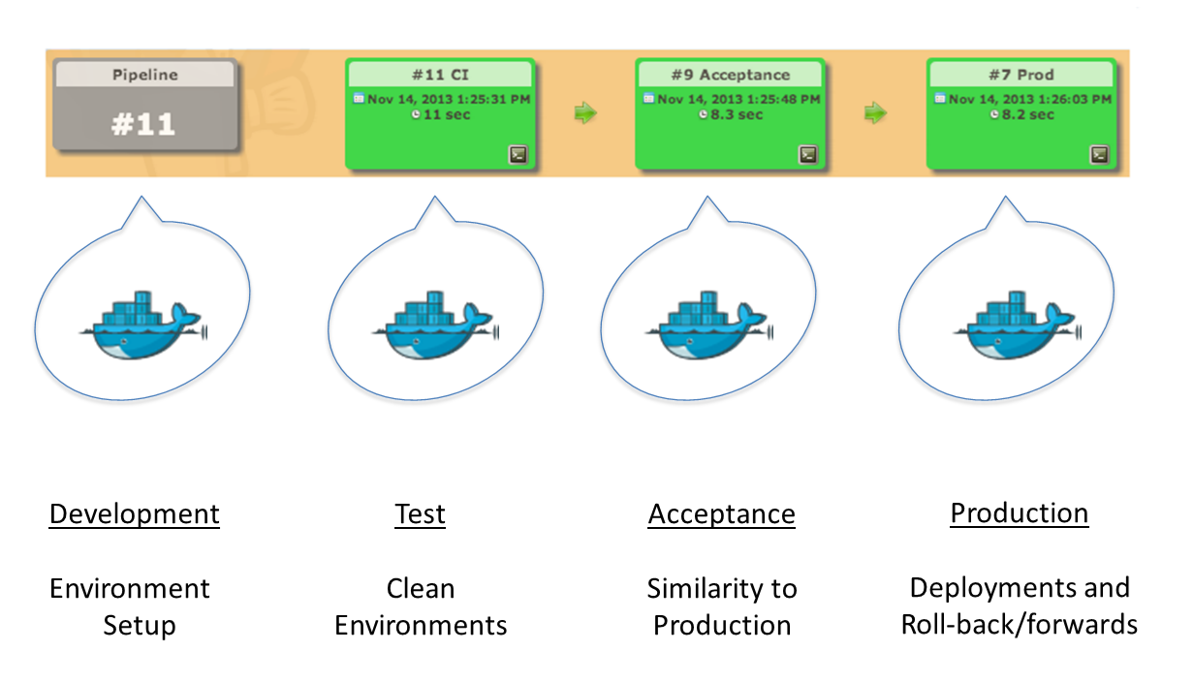
Delivery Pipeline with Containers

Slide 15
Docker – value addition for DevOps
Fast
Runtime performance near bare metal speeds
Management operations (run, stop , start, etc.) in seconds / milliseconds
Agile
VM-like agility – it’s still “virtualization”
Flexible
Containerize “application(s)”
Lightweight
Does not have its own Operating System, like a VM
Images only contain bin, lib and app
Inexpensive
Open source – free – lower TCO
Supported with out-of-the-box modern Linux kernel
Ecosystem
16,000+ Apps in Docker Hub
Vibrant community & numerous 3rd party app
All Cloud providers - AWS, VMware, Google App Engine support Docker

Slide 16
Why should we care ?
For Developers
For DevOps
Portable App containers
Build, test & package on production like environment
Increase the quality of code produced by Developers
Fast and simple
16,000+ apps available on Docker Hub
Reducing “works on my machine” finger-pointing
Helps Infra teams to deploy & run any App on any infrastructure
Entire lifecycle more efficient and repeatable
Compared to VM's, reduces costs & improves speed
Deployment & Release Automation
Perfect for DevOps – CI, CD, Release, Scaling, Clouds, etc
Simple creation of Environments
Provide standard Environments for Dev, Test & Production

Slide 17
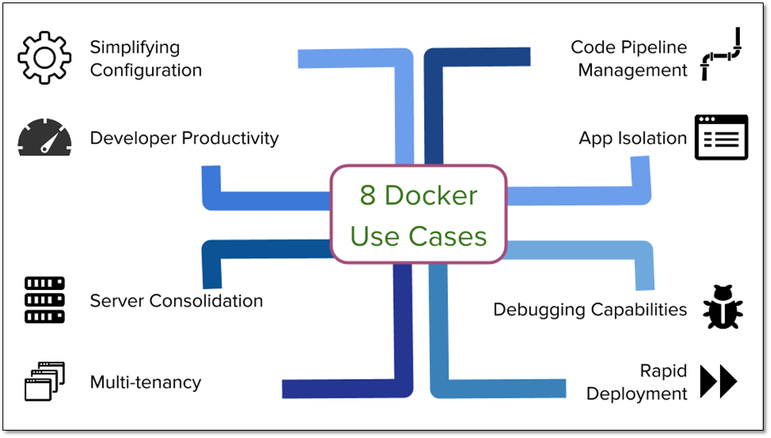
Use cases for Docker
Automating packaging & deployment of Applications
Continuous integration/deployment
Automated testing
Zero downtime
Creation of PAAS environments
Scaling Web apps, databases and backend services
Micro-services architecture / Service orchestration & discovery

Slide 18
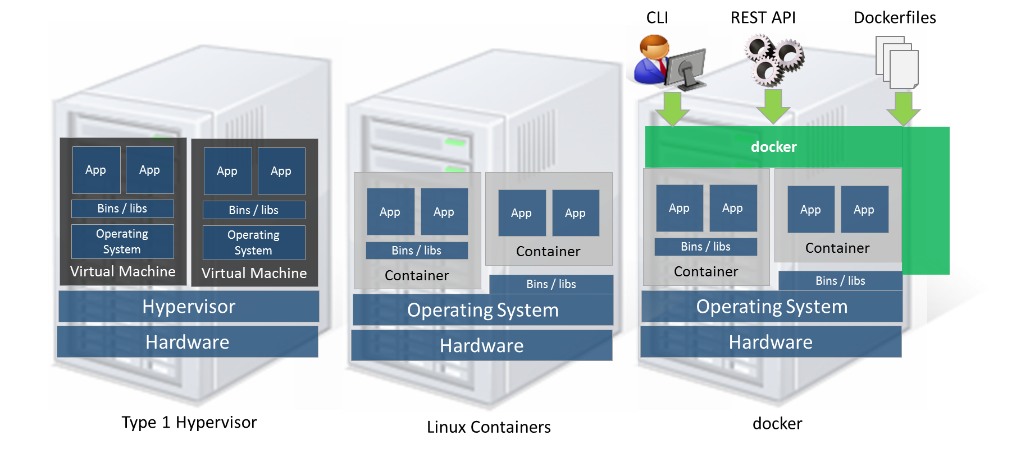
Evolution in Virtualization History

Slide 19
Dockerfile
FROM progrium/busybox
MAINTAINER Kailash Verma
RUN opkg-install curl ca-certificates
ENV JAVA_HOME /usr/jdk1.8.0_25COPY jre1.8.0_25 /usr/
RUN ln -s $JAVA_HOME /usr/java && rm -rf $JAVA_HOME/man
ENV PATH ${PATH}:${JAVA_HOME}/bin
ENTRYPOINT [ "java" ]CMD [ "-version" ]

Slide 20
Docker Commands
Command | Description
Build | Builds Docker images from a Dockerfile
Commit | Create a new image from a container's changes
cp | Copy files/folders from a container's filesystem to the host path
create | Create a new container
exec | Run a command in a running container
history | Show the history of an image
images | List images
info | Display system-wide information
inspect | Return low-level information on a container or image
kill | Kill a running container

Slide 21
Docker Commands
Command | Description
load | Load an image from a tar archive
login | Register or log in to a Docker registry server
logout | Log out from a Docker registry server
logs | Fetch the logs of a container
pause | Pause all processes within a container
unpause | Unpause a paused container
port | Lookup the public-facing port that is NAT-ed to PRIVATE_PORT
list | List containers
Pull | Pull an image or a repository from a Docker registry server
push | Push an image or a repository to a Docker registry server

Slide 22
Docker Commands
Command | Description
rename | Rename an existing container
restart | Restart a running container
rm | Remove one or more containers
rmi | Remove one or more images
run | Run a command in a new container
save | Save an image to a tar archive
search | Search for an image on the Docker Hub
start | Start a stopped container
stats | Display a stream of a containers' resource usage statistics
stop | Stop a running container

Slide 23
Docker Commands
Command | Description
tag | Tag an image into a repository
top | Lookup the running processes of a container
version | Show the Docker version information
wait | Block until a container stops, then print its exit code

Slide 24
Any Questions?

Slide 25
Thank You!

